Slide 1
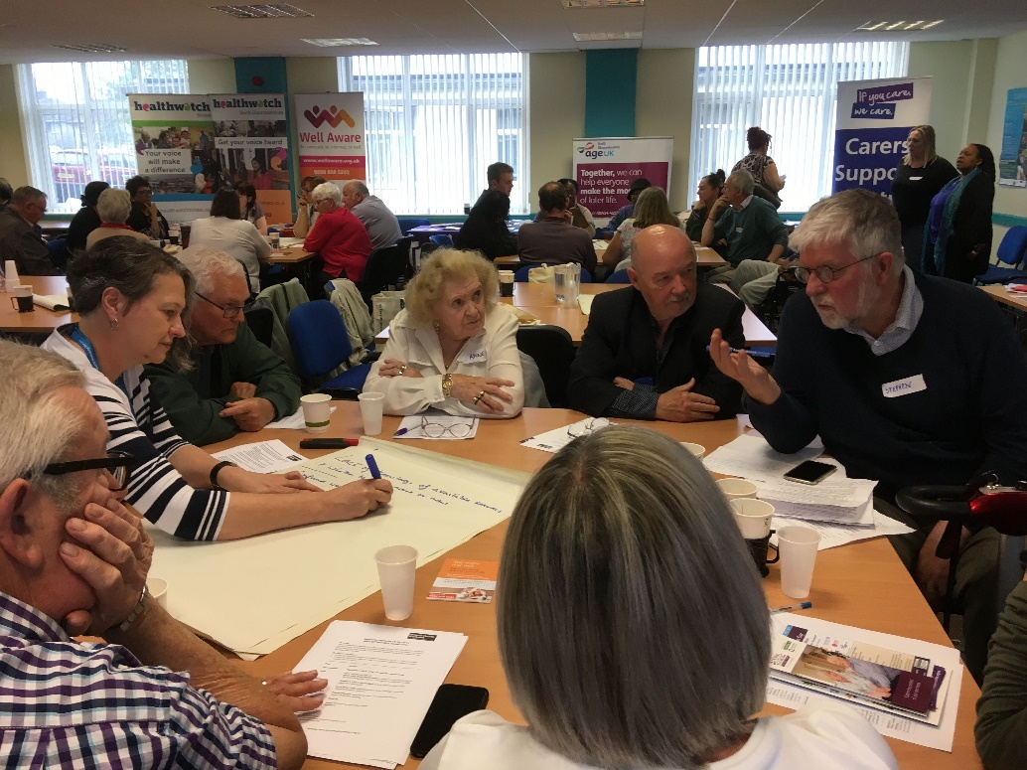
On behalf of Bristol Health Partners Welcome
Speakers:
Kate Uzzell, South West Co-ordinator of Road Peace
Nicholas Crease, Major Trauma Practitioner, Major Trauma Team, Southmead Hospital
Professor Adrian Davis, SHINE, Bristol Health Partners
Notes:
Slide 3 – Achievements
Supported leadership of patients and members of the public
Over half of our HITs have public contributors in their leadership teams
All have links to public contributors to shape their work
Public contributors are at every level of the partnership from the Board, to HITs, to recruitment of core team members
Enabled significant research income
In the six years we’ve been counting, we’ve helped to attract over £40M in research funding in BNSSG
That has meant new jobs, new knowledge and insights
AHSC designation
In 2020, international recognition by designation as an Academic Health Science Centre
Built on strengths across many organisations, networks – not just Bristol Health Partners
Helps us attract grant funding, recruit best talent into our system and network with the leading centres across the country
Most importantly, we’ve made a difference. Our HITs have helped to improve lives and services in our region.
Increasingly, they are working with more diverse communities – I’m proud that the partnership is taking a lead in this area, and will continue to make it a priority
Will now share some examples of HIT impacts

Slide 2
Best Practice lessons from cities implementing Vision Zero and Safe Systems Road Safety: The quest for an end to deaths & life changing injuries on Bristol’s road network. Best Practice lessons from cities implementing Vision Zero and Safe Systems Road Safety (bristolhealthpartners.org.uk)
Dr Adrian Davis FFPH adrian.davis@uwe.ac.uk 17th November 2022
Avon and Wiltshire Mental Health Partnership NHS Trust Bristol, North Somerset and South Gloucestershire Integrated Care Board NHS Blood and Transplant North Bristol NHS Trust University Hospitals Bristol and Weston NHS Foundation Trust
Notes:
Slide 1 – Intro
Intro self
In our 10th year, will reflect on where we’ve come from, achievements along the way and why I think the partnership has endured

Slide 3
Mobility beats safety… who bears the burden?
In most cities including in High Income Countries, approximately 80% of road traffic deaths are pedestrians and cycle users with pedestrians comprising the majority and with poorer residents significantly more likely than wealthier residents to be among the injured and killed.
As the OECD notes, in some cities the figure is higher.

Slide 4
The road to Safe Systems Road Safety
In 1997 Swedish Parliament made a historic decision to no longer accept deaths and life changing injuries in the traffic system as a price for personal mobility. They adopted Vision Zero.
Supported by WHO the OECD, and World Bank. Vision Zero from Sweden has now become part of the wider concept of Safe Systems Road Safety.
One of the first cities in the UK to develop a Safe Systems Road Safety Plan was Bristol (2015).

Slide 5
How is SSRS more effective than past approaches?
Many countries, states, and cities that have adopted a Safe System approach have reduced road fatalities at a faster rate than others that followed the traditional approach (e.g. crash site clusters).
Analysis of traffic fatalities in 53 countries between 1994 and 2015 revealed that countries that have adopted a Safe System approach have both the lowest rates of fatalities per 100,000 inhabitants and the fastest rate of change in fatality levels.
Ref: World Resources Institute, 2018. Sustainable & safe. A vision and guidance for zero road deaths. Washington: USA.

Slide 6
Individual city brief case studies
Oslo (Norway)
The Mayor, City Council, and transport division staff all supported a shift in roadway decision-making from car-centric to people-centric.
The city government set a goal to reduce car traffic by one-third by 2030, meaning that road safety measures could largely be implemented without traffic studies even if they were believed to cause congestion or slow down traffic.
The authority to designate bus lanes, bike lanes, one way traffic and close streets to traffic was transferred from the police to the city government, allowing swift transformation of parking lanes to bike lanes and closure of cut through streets.
The city implemented a bicycle strategy, with an aim to increase the bicycle mode to 25 percent by 2025.
The city launched a smart phone app for children in school, where they can report traffic hazards and request road safety measures directly to the road authority. It is used by children at 98 schools (more than half of all schools in the city), and has gathered more than 60,000 reports from children so far.
Oslo announced that it would make the city centre car-free by 2019. The project has led to a removal of all regular street parking in the city centre, and the centre has been closed to through traffic.

Slide 7
In Norway in 2019, no children died in traffic crashes, and there were only two fatal injuries per 100,000 inhabitants.
The risk of fatal or serious road traffic injuries, on a trip-by trip basis, has fallen 47 percent for cyclists, 41 percent for pedestrians, and 32 percent for drivers between 2014 and 2018. Oslo reported no pedestrian or cycle user road traffic deaths in 2019 and one car driver (down from a 3 year average 2010-12 of 7).

Slide 8
New York
The New York City (NYC) Vision Zero program began with the support of a well-organized, politically influential advocacy group, Transportation Alternatives, that publicised the basic Safe Systems concepts as early as 2011, highlighting advances made in other nations and laying out a blueprint for adoption in NYC.
The report gained the attention of safety advocates and was subsequently adopted as part of the political platform of the leading candidates in the 2013 mayoral election.
NYC, Bill de Blasio, announced adoption of the City's Vision Zero Action Plan in January 2014.
Previous to Vision Zero adoption, the Action Plan reported that approximately 4,000 New Yorkers were seriously injured and more than 250 were killed pa in crashes.
Being struck by a vehicle is the leading cause of injury-related death for children under 14, and the second leading cause for elders.
On average, motor vehicles seriously injure or kill a New Yorker every two hours (New York City Vision Zero Action Plan, 2016). According to the Action Plan, dangerous driver choices, like speeding and failing to yield, are the primary cause of 70 percent of pedestrian fatalities.

Slide 9
Some results
New York City traffic deaths fallen by a third since year before Vision Zero began, bucking nationwide trend towards increased fatalities. In addition, a Streets Plan, launched Dec 2021, commits the US Dept of Transportation, to meeting the following benchmarks by Dec. 31, 2026:
150 Miles of physically or camera-protected bus lanes
4,750 Transit signal priority at intersections
250 Miles of protected bike lanes
2,500 Bus stop upgrades like benches, shelters, and real-time passenger information
2,000 Redesigning signalized intersections
2,500 Accessible pedestrian signals at intersections
Assess and amend commercial loading zones and lorry routes
Develop parking policies to promote the master plan’s goals of safety, mass transit use, reduced vehicle emissions, and access for individuals with disabilities
Create and maintain one million square feet of pedestrian space.

Slide 10
Some results cont.
Another factor that facilitated early and quick adoption of Vision Zero in New York City was a movement among residents who lost loved ones to traffic injuries.
Families for Safe Streets was formed by people who lost loved ones to traffic crashes, or survived serious traffic injuries themselves. Their victim advocacy contributed to a movement away from victim blaming and enabled important progress.

Slide 11
8 Steps to kick-starting SSRS in Bristol
Structural issues
Step 1 - Leadership
A clear signal of political leadership from the City Council is required to help galvanise resources and promote a vision for a safer traffic environment, not least for those most vulnerable. This will also require the creation of a alliance of key agencies including the NHS, advocacy groups, the emergency services, academic researchers, and the private sector as the vision should be shared across the city and its institutions and agencies, as well as establishing strong community engagement.
Step 2 – Upstream approach
SSRS requires a shift to an up-stream approach, which is pro-active and ethically led in seeking the eradication of deaths and life-changing injuries on the highway. A clear and shared understanding of what SSRS is should be established at the earliest opportunity and how it should be actioned. Here the value of public health approaches, with whole population strategies, and systems thinking, is likely to help move beyond traditional approaches focused on influencing individual behaviour, with its attendant risk of victim blaming.
Step 3 – The system and system designers
Greater attention should be focused on improving the transport system itself, particularly the built environment, policies, and technologies that influence behaviour. Furthermore, that system designers - highways engineers, planners, urban designers and other professionals - play a primary role.
Step 4 – Speed is critical
Commit to speed management as a fundamental of SSRS.

Slide 12
Intervention approaches
Step 5 – Data, intelligence, networks
Data and intelligence are critical elements to understanding intervention priorities and programmes. This includes the need for regular measurements and reporting. It includes the establishment of protocols for the collection of injury data from NHS and emergency services. The City Council is part of the ITF (OECD) Safer City Streets Initiative, and this provides a ‘ready-made’ network for international comparisons. UK networking on SSRS should also be established or developed.
Step 6 – Focus on protecting vulnerable road users
Prioritise protecting vulnerable road users given the disproportionate burden of injury and death placed on these groups. Noting that a relatively small number of roads tend to be where a disproportionate number of KSI events occur implementation approaches of cities like Oslo, through expanded designated bus and bike lanes, the transfer of parking bays for bicycle lanes, and a car-free city-centre.
Step 7 – Enforcement remains important
Enforcement has always been a part of the approach to road safety whether through camera technology or officers on the streets. Therefore, it remains important that Avon and Somerset Constabulary retain a clear role, understand and are wholly supportive of the SSRS approach.
Step 8 – The importance of advocacy and community engagement
Community advocacy and engagement has been shown to be a powerful force through which to create an environment supportive of SSRS – such as in New York City and San Francisco. In Bristol key groups at likely to include the Bristol Walking Alliance, Bristol Cycling Campaign, Playing Out, and the Civic Society, and representative groups for young people, among others.

Slide 13
Conclusions
Whilst there is not a large evidence base as to what cities in High Income Countries have been doing to make SSRS the default approach to the elimination of road traffic deaths and life-changing injuries, where it has been implemented it can be highly effective (Oslo, New York, San Francisco, Boston).
The 8 steps provide an initial route-map in helping find a pathway. Some of the steps may seem too ambitious, while others are already well advanced.
On the way there will be barriers to progress, from funding, lack of will and kick-back from some of the existing systems operatives holding different values, and more generally traditional traffic safety cultures.
As noted above by Australian researchers, implementation challenges of Safe System are political and social, rather than technical. But these are simply challenges along the way to be met and overcome. The important action now is in taking some of these steps to save lives and reduce injury and trauma.

Slide 14
Any questions?

