Slide 1
Safer Roads
Nicholas Crease – Major trauma Practitioner
Southmead Major Trauma Centre

Slide 2
Will’s Story…

Slide 4
Southmead MTC
2017 – 2022
1810 vehicle incidents leading to major trauma

Slide 5
Southmead MTC
Where?

Slide 6
Southmead MTC
What is injured?
And how badly?

Slide 7
Southmead MTC
5.3% mortality rate
97 Lives
2017 – 25
2018 – 26
2019 – 16
2020 – 13
2021 – 18
What about the 1,713 Survivors?..

Slide 8
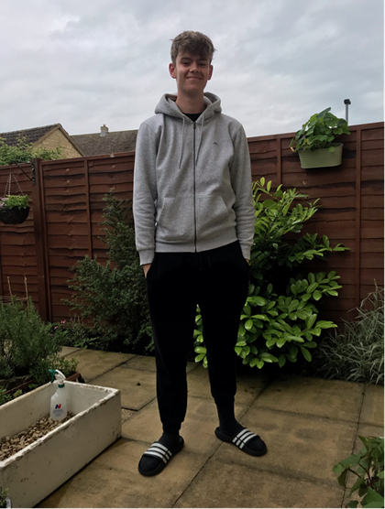
Will…

